Slide 1
Software Quality Assurance Planning

Slide 2
Software Quality Assurance
Used to Monitor and Improve the Software Development Process
Making Sure That Standards and Procedures are Followed
Ensures that Problems are Found and Dealt with
Orientated to ‘Prevention’

Slide 3
Software Quality Assurance
Planned and Systematic Approach to the Evaluation of the Quality of and Adherence to:
Software Product Standards
Processes
Procedures
Assures that Standards and Procedures are Established and Followed throughout the Software Development Process
IEEE ISO 9000 Certified

Slide 4
Content of SQA Plan
The IEEE Standards for SQA Plans states that the plan should contain the following sections:
Purpose
Reference documents
Management
Documentation
Standards, practices and conventions
Reviews and Audits

Slide 5
Content of SQA Plan
Configuration Management
Problem reporting and corrective action
Tools, techniques and methodologies
Code control
Media control
Supplier control
Records collection, maintenance and retention

Slide 6
Purpose
This states the specific purpose and scope of the SQA plan. It names the software product that it covers and describe its use.

Slide 7
Referenced documents
A complete list of the documents referenced in the plan.

Slide 8
Management
IEEE standard lays down three aspects that should be covered in this section of the Quality Assurance Plan:
Organization
Tasks
Responsibilities

Slide 9
Organization
It is about the project organization, roles of team members, their hierarchy etc. It is important that head of SQA function in the organization has authority to be able to perform independent verification that the processes are adhered to.

Slide 10
Tasks
The sequence of tasks, which need to be performed, includes:
Preparing preliminary software requirements specification; perhaps as a part of the development of a system involving hardware and software
Preparation of a software configuration plan, a software quality assurance plan and a software development plan which may or may not include the other two documents
Software requirements review
Software design review
Preparation of software requirements specification
Conducting review of software requirements specification document

Slide 11
Tasks
Preparing a software test plan
Preparing a top-level software design
Preparing a draft support documentation, e.g. user manuals.
Top level software design review
Preparing software test description
Production of a detailed software design
Detailed software design review
Production of software test procedures
Production of source code and object code for the code units

Slide 12
Tasks
Testing of code units
Integration of software modules/units
Testing of integrated software units
System integration and systems integration testing
Acceptance Testing

Slide 13
Responsibilities
The quality manager will:
Define the responsibilities of quality personnel in the form of quality assurance procedures applicable to the project
Agree to the quality plan with the project manager.
Approve the plan of audits for the project which are to be carried out by quality personnel
Resolve any disagreement between the project manager and quality personnel on matters relating to quality
Review of activities performed by project personnel to ensure that the requirements of the quality plan and quality procedure are being satisfied
Review the contents of software standards, engineering codes of practices and quality procedures for adequacy and efficiency

Slide 14
Responsibilities
Quality personnel will:
Carry out planned internal audits of the project to assess compliance with quality objectives.
Agree on corrective action with the project manager for any discrepancies, non-conformities found and ensure that corrective action is taken
Evaluate defect trends and take appropriate action
Refer any unresolved discrepancies to the quality manager for resolution

Slide 15
Documentation
This section will normally include the following:
Software Requirements Specification (SRS)
Software Design Description
Software Verification Plan
Software verification report
References to Software standards and procedures mentioned and defined as in the Quality Manual
Configuration Management Plan
Software Quality Objectives

Slide 16
Standards, Practices and Conventions
This section of the SQA plan should contain at a minimum, the following:
Documentation standards
Logic structure standards
Coding standards

Slide 17
Reviews and Audits
This section of the SQA plan will state which technical and managerial reviews will be undertaken and how they will be carried out. The ANSI standards suggests that the following would be the minimum set of reviews:
Software Requirements Specification Review: this review is held to approve the document defining the software requirements specification and it aims to check the adequacy of the requirements.

Slide 18
Reviews and Audits
Preliminary Design Review: The purpose of this review is to approve formally, the software top-level design document. These will be included ensuring that:
The design was produced in accordance with the development standards chosen to implement the selected methodology
All the necessary tasks were undertaken (Joint Application Review, Proof of Concepts etc)
The top-level design is an adequate basis for future work
The top-level design, when implemented, will satisfy any sizing and timing constraints
The software top-level design document was produced in accordance with the organization's standard and is internally consistent, understandable, complete and appropriately detailed

Slide 19
Reviews and Audits
Critical Design Review: The purpose of this review is to approve the software detailed design document as a basis for further development work. These will be included ensuring that:
The design was undertaken in accordance with the organization’s standards and is technically feasible
All the necessary tasks have been undertaken (Application architecture, entity relationship diagrams, entity history diagram, state transition diagrams etc)
The detailed design was internally consistent, understandable, complete and appropriately detailed
Traceability is maintained through the top-level design to the software requirements specification
Test cases for unit test and integration test have been prepared as part of the design and have been checked for consistency with the organization’s standards

Slide 20
Reviews and Audits
Software Verification Review: The purpose of this review if to approve the test plan. It is an evaluation of the completeness of the methods described.
Functional Audit: This is held to verify that all the requirements in the software requirements specification have been met.
Physical Audit: This is held to verify that the software and its documentation are internally consistent prior to delivery to the user.
In-Process Audits: In-process audits of a sample design are held to verify the consistency of the design.
Management Review: It is important that the execution of the quality plan is evaluated and there will be one or more reviews of this.

Slide 21
Configuration Management
We’ll undertake detailed discussion about this in a separate chapter dedicated to this topic. This section of the SQA plan will cover configuration identification, configuration control, configuration status accounting, and configuration auditing.

Slide 22
Problem Reporting and Corrective Action
This section of the SQA plan will describe the system, which ensures that software problems are documented and resolved. It should be a closed-loop system. All the problems should be reported at appropriate level, acted upon and resolved.

Slide 23
Tools, Techniques and Methodologies
This section of the SQA plan should identify the special software tools, techniques and methodologies employed that support quality assurance, state their purposes and describe their uses.

Slide 24
Code Control
In a software project, this is likely to be implemented in conjunction with the library function.
The library receives and maintains copies of all software tools and documentation.
The library will issue all material and ensure that the most recent authorized version is available.
Access to code files is controlled to ensure that no unauthorized use or modification takes place.

Slide 25
Media Control and Back Up
This section of the SQA plan will describe how the media are to be protected from unauthorized access or damage. Security threats to a software project come from the following environment factors:
Fire Damage
Water Damage
Energy Variations
Unauthorized Intrusion
Viruses and Worms
Misuse of Software, Data and Services

Slide 26
Supplier Control
This has relevance while outsourcing some components of a software project. It is important that externally developed software is of the appropriate quality.

Slide 27
Records Collection, maintenance and Retention
Any successful project will undergo substantial maintenance over a long period.
It is important to ensure that all the documentation necessary to undertaken this quickly, efficiently and cheaply is going to be available when required.

Slide 28
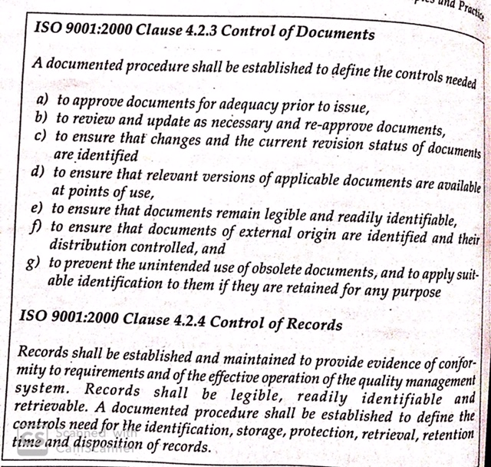

Slide 29
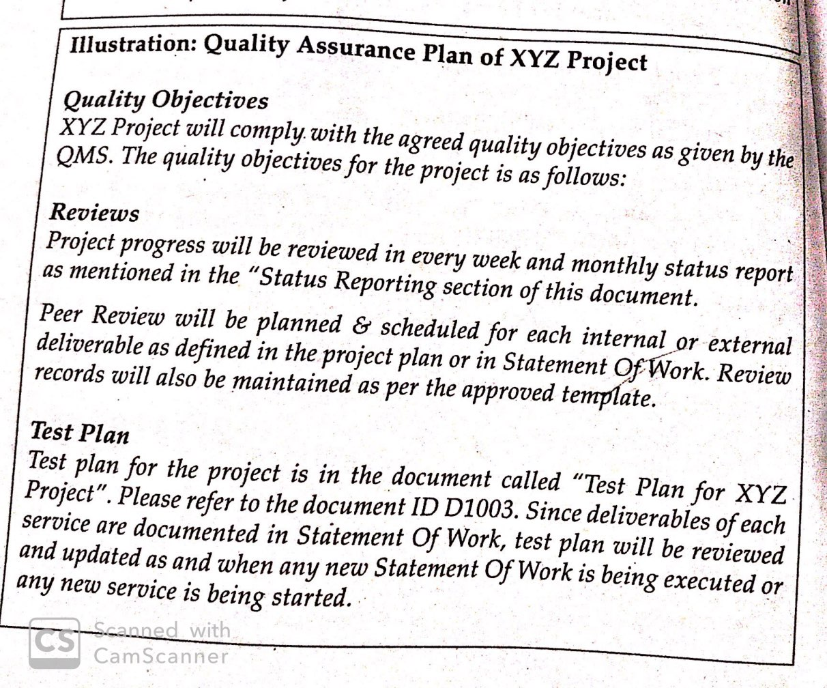

Slide 30
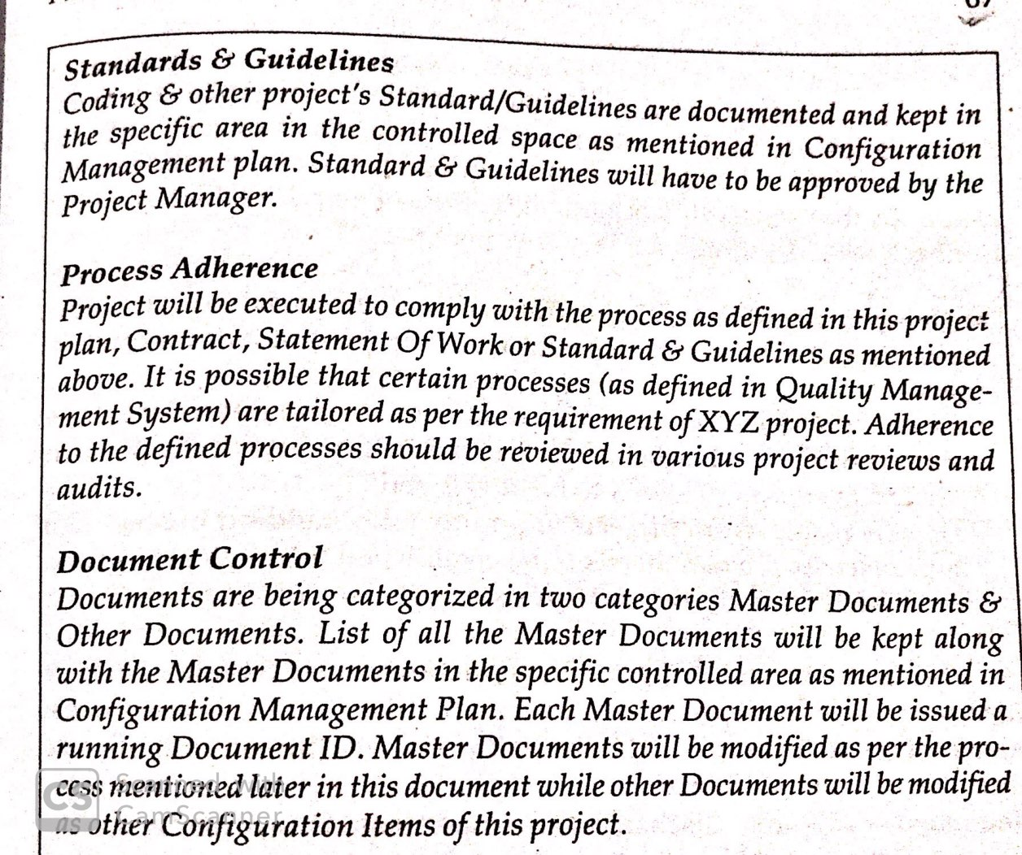

Slide 31
SQA: Organization Level Initiatives
Process Management: Organization level activity is like a close feedback loop. Its aim is to:
Define a standard software process: You need a method to define the procedure, to develop and maintain process documentation and a usable set of software process assets.
Ensure that each project uses an appropriate version of the standard process that has been tailored to its individual needs. For this “tailoring guidelines” need to be developed.
Use the results from projects to improve the standard process. For this a metrics program needs to be established.

Slide 32
SQA: Organization Level Initiatives
Standard Process Definition: Organizations need to establish, document and maintain a standard software process. The process for process definition should typically address:
Activities in Process Definition
Develop and maintain organization’s software process.
Identify organization’s software process
Define/Change organization’s software process
Document the process
Review and approve the process
Release, distribution and retirement of QMS document

Slide 33
SQA: Organization Level Initiatives
Identification and documentation of software life cycles, methods and tools
Develop and maintain tailoring guidelines for projects
Guidelines for writing a process document
Guidelines for creating a release notice for announcing the new/modified processes
Guidelines for reviewing new process documents
Guidelines on process release

Slide 34
SQA: Organization Level Initiatives
Each project has its own approved life cycle that defines:
Required procedures, practices, methods and technologies
Applicable process and product standards
Responsibilities, authorities and staff interrelationships
Required tools and resources
Process dependencies and interfaces
Process outputs and completion criteria
Product and process measurements to be collected.

Slide 35
SQA: Organization Level Initiatives
Software Process Measurements: It is said that you cannot “improve” something that you cannot “measure”. Therefore it is essential to take measurements of the performance of the standard software process, as applied to individual projects.
In developing a metrics program, the following issues need to be resolved:
“What” should be measured?
“Why” should be measured?
“How” it should be measured?

Slide 36
SQA: Organization Level Initiatives
“Who” should measure it?
“When” and “Where” in the process it should be measured
Most important thing is to have a linkage of these measurements to organization’s ability to meet the requirements of its customers.
The selected metrics should therefore:
Be linked to real customer requirements
Support the overall goals and objectives of the measurement program
Support predefined analysis activities
Be consistent across all projects
Cover the entire life cycle, including support and maintenance

Slide 37
SQA: Organization Level Initiatives
Example of specific measurements that can be used are:
Estimated versus actual size, cost and schedule date.
Quality measurements as defined in the quality plan (Productivity, effort, defect removal efficiency etc).
Number and severity of defects in requirements, design and code
Number and cost of changes to approved requirements and design specifications
Number and turnaround time of customer requests and bug reports (customer reported bugs)

Slide 38
SQA: Organization Level Initiatives
Defect Prevention: It is concerned with ensuring that sources of defects that are inherent in the software process, or of defects that occur repeatedly are identified and eliminated. The defects are identified from following inputs:
Process wind up reports
Organizational metrics analysis
Audit & Assessment reports
Other organizational level meetings

Slide 39
SQA: Organization Level Initiatives
At the project level, it is essential to include defect prevention activities in the project development plan and schedule.
Defects can be categorized by cause, such as inadequate training, breakdown of communications, oversight of important details, or manual errors.
The activity of finding out the causes for defects and classification of defects is known as casual analysis.

Slide 40
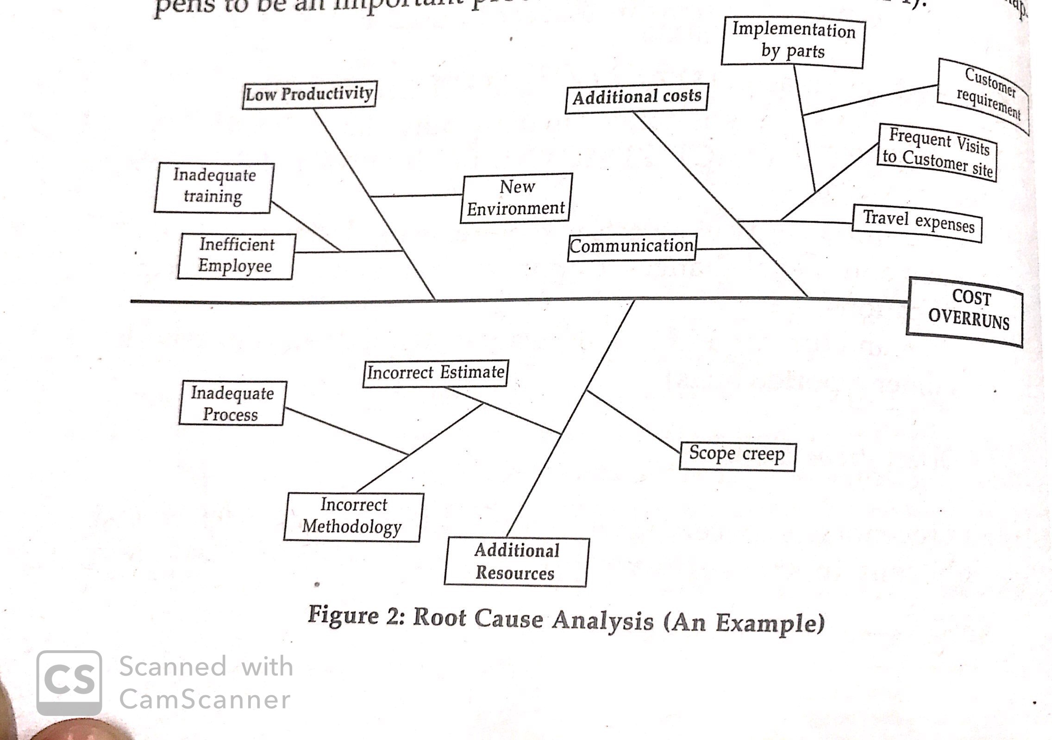

Slide 41
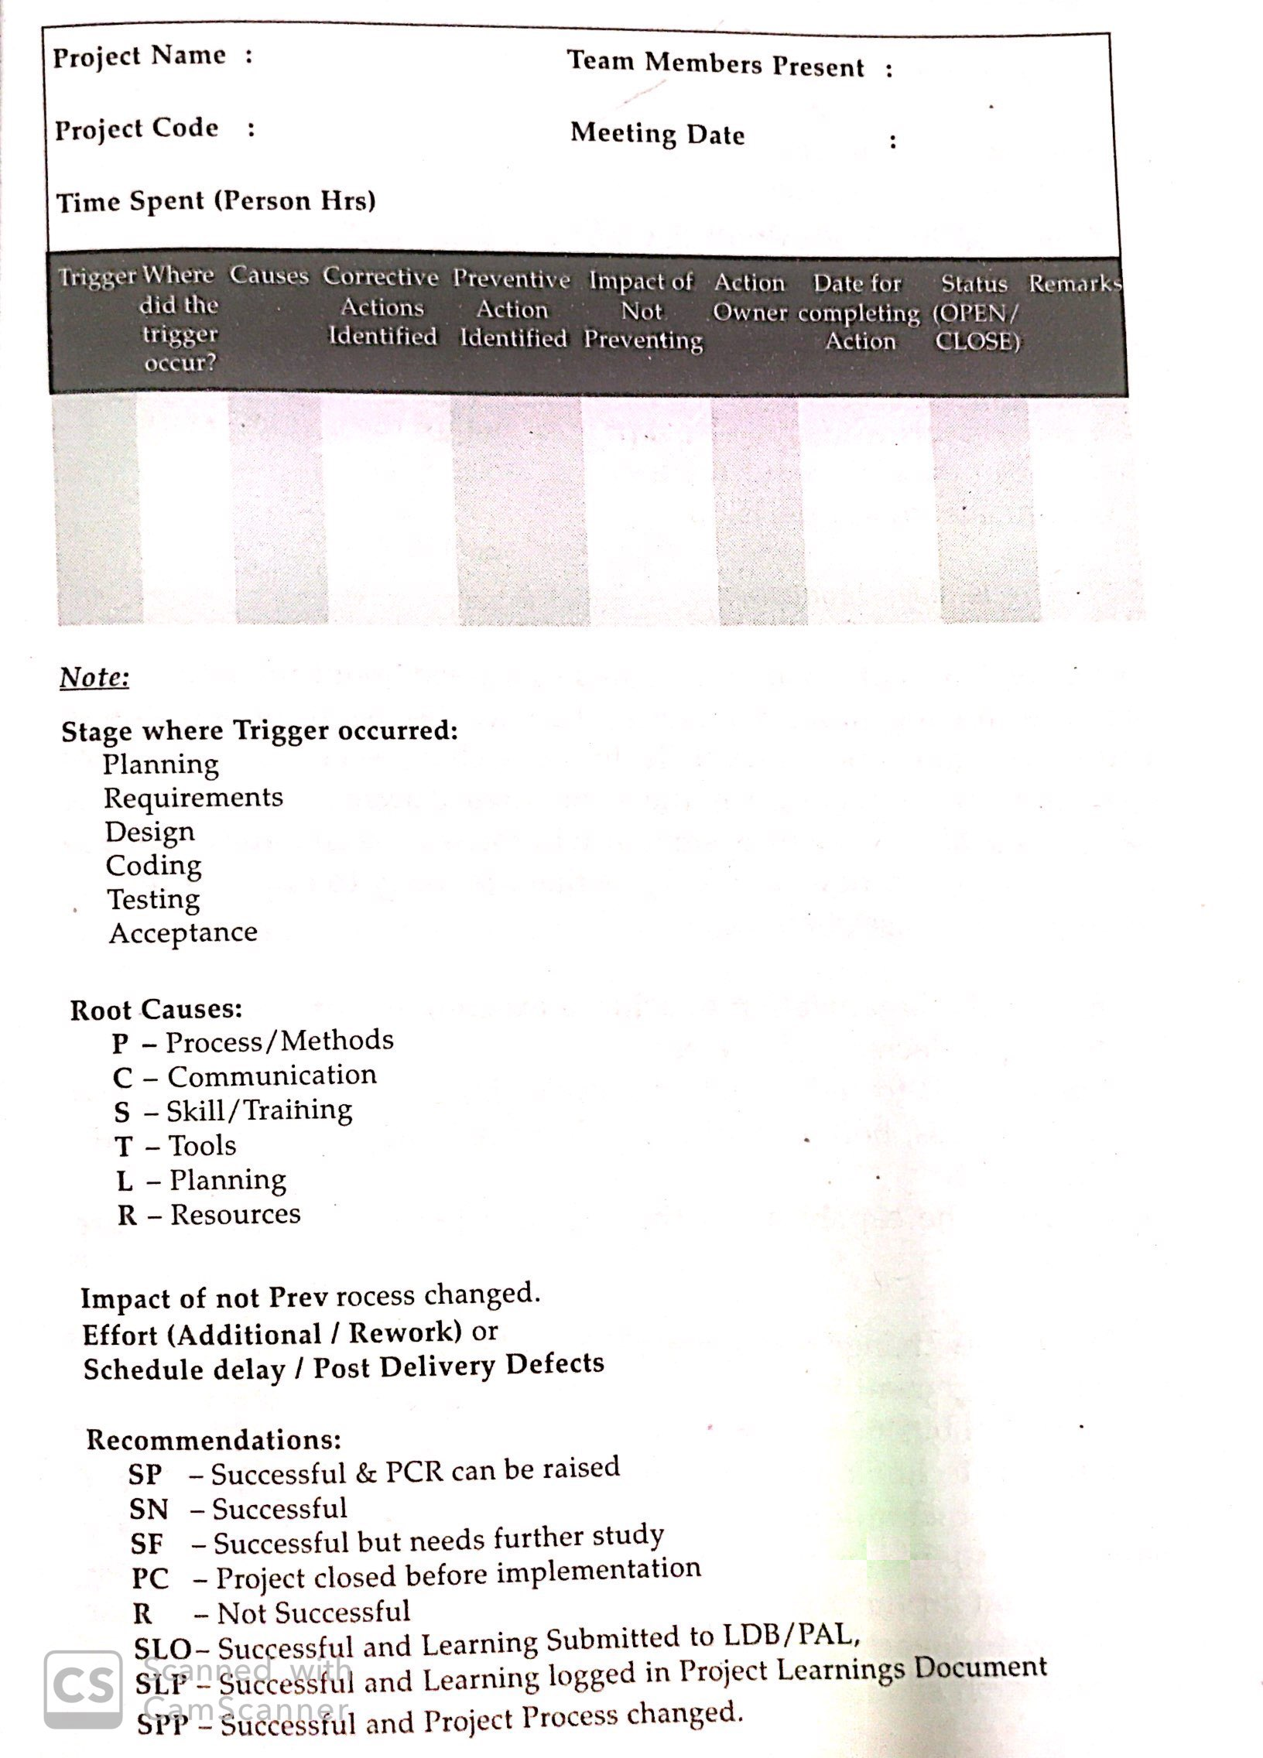
Format for maintaining a record of Root Cause Analysis is suggested below:

Slide 42
SQA: Organization Level Initiatives
Proposed defect prevention actions such as the following:
Description of the defect
Description of the cause
Category of the cause
Stage where the defect was identified
Description of the proposed action
Whether the proposed action is feasible or not
Person responsible for implementing the action

Slide 43
SQA: Organization Level Initiatives
Date by which the action is to be completed
Description of the areas affected by the corrective action
Individuals who are to be kept informed of the action’s status
Date of the next status review
Rationale for key decision
Technology innovation: It will focus on technology changes or introduction of new technologies that are likely to improve the capability of it. These changes:
Enable the organization to achieve exacting quality standards resulting in decreases in defects

Slide 44
SQA: Organization Level Initiatives
Empower it to reduce process cycle times and increase process effectiveness, both of which would in turn improve productivity and quality
Improve the capability of the organization’s standard software processes

Slide 45
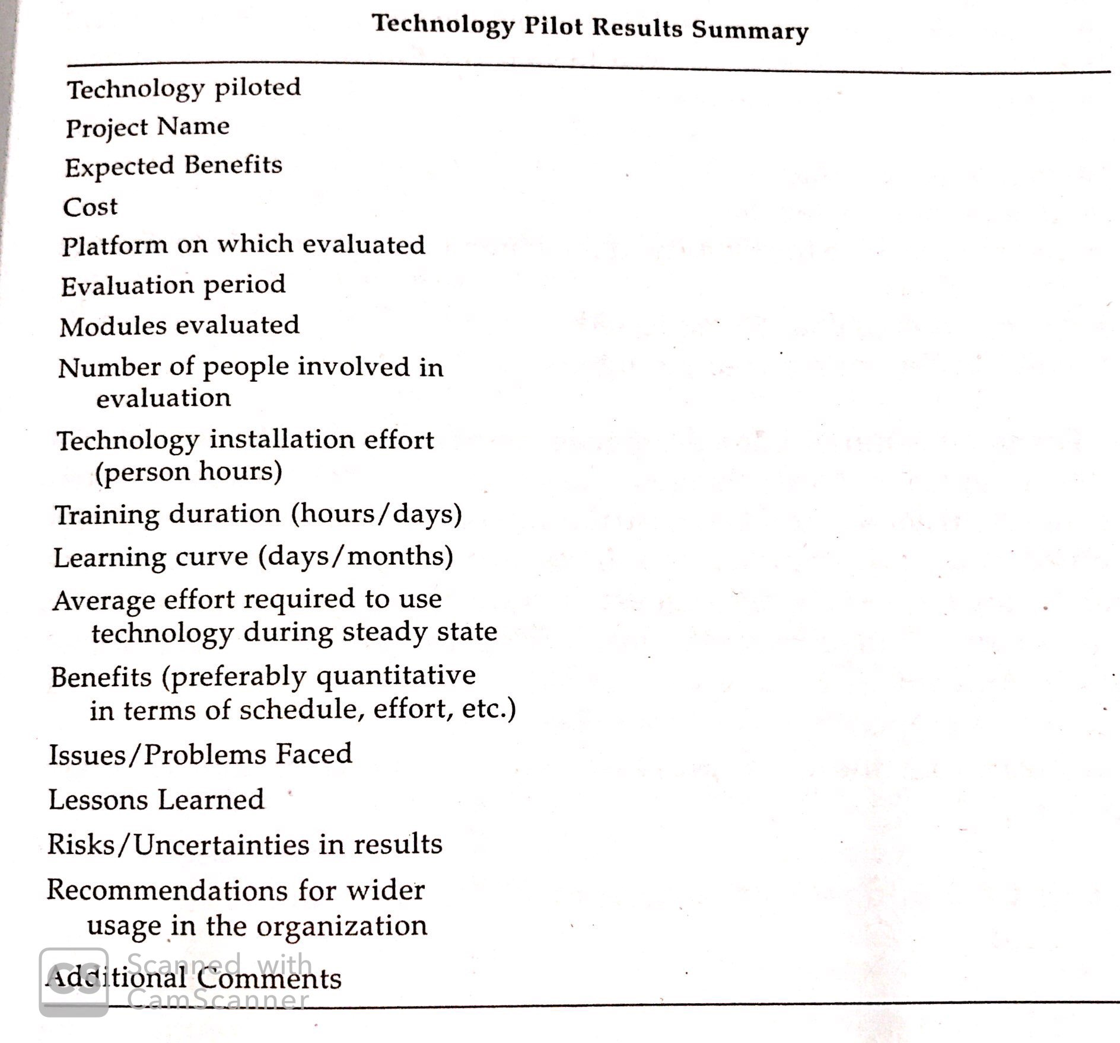
Technology Pilot Results Summary

Slide 46
SQA: Organization Level Initiatives
Process Change Management: Sources of inputs for process change are:
Findings and recommendations from Audits and Assessments
Lessons learnt from monitoring process activities
Change proposals from project staff and managers
Analyzed and interpreted processes and product measurement data
The format for Process Change request should include the following:
Requester’s Name
Requester’s contact no
Ref to process in the Quality Management system for which change is requested
Description of change requested
Justification for the change suggested

